Slide 1
NASA Human Exploration Rover Challenge
Estelle Fortes
Embry-Riddle Aeronautical University

Slide 2
Introduction
Project Approach
Competition Design Requirements
Subsystems
Objective
Design
Challenges
Future work
Questions

Slide 3
Project Objectives & Approach
Objectives:
Give first- year students early engineering experience
Build foundational skills
Instill enthusiasm for engineering
Approach:
6 subsystems led by upper-class engineering students

Slide 4
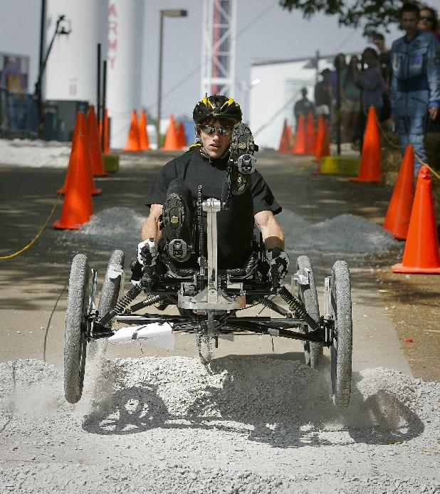
NASA Human Exploration Rover Challenge
Formerly NASA’s Great Moonbuggy Race
Held annually in April at U. S. Space & Rocket Center, Huntsville AL
Course simulates the rugged terrain of planets, moons, asteroids and comets
2013 Competition
Courtesy of Google

Slide 5
Competition Design Requirements
Human powered (Male and Female)
Collapsible into 5ft cube
Must be carried 20ft
15in. clearance from ground to human extremities
Non-pneumatic tires
AIAA Electronics Award

Slide 6
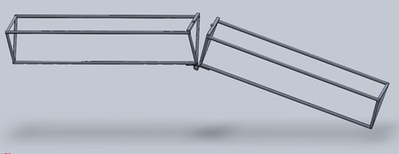
Subsystem 1: Structure
Requirements:
Collapsible into 5ft cube
Easily carried
Design:
8 ft triangular truss design
4043 Steel Chromyl or 6061-T6 Aluminum
Hinge system
Challenges:
Inexperience with structural design and analysis
CAD rendering – CATIA & ANSYS
Picture?

Slide 7
Subsystem 2: Suspension
Requirements:
Absorb terrain shock for 400lbs
2.5G instantaneous load
Design:
Independent suspension system
Push rod design
Challenges:
Lack of specific course characteristics
Inexperience with structural analysis

Slide 8
Subsystem 3: Steering
Requirements:
Simple control system for vehicle
Design:
Recumbent seats – beneath seat handlebars
Small piston to buffer shocks transmitted through handlebars
Challenges:
Integration of bar linkage system to drivetrain

Slide 9
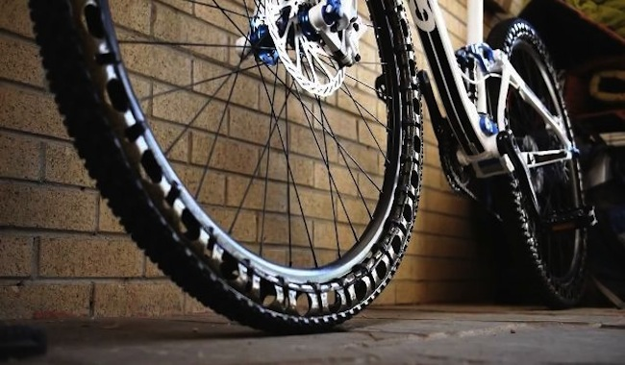
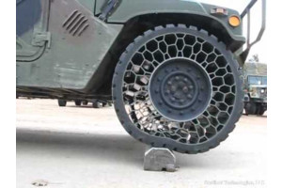
Subsystem 4: Wheels & Tires
Requirements:
Non- pneumatic tires
15 in clearance
Design Options:
Solid Rubber tires
Energy Return wheels
Honeycomb
Challenges:
Cost constraint
Lead time
Weight

Slide 10
Subsystem 5: Drivetrain
Requirements:
Transfer power from rider to wheels
Avoid skidding while turning
Design:
Independent wheel system
System of CVP NuVinci N360 hubs, gears, chains, and pedals
Challenges:
Understanding gear ratios
Integrating with wheels and tires

Slide 11
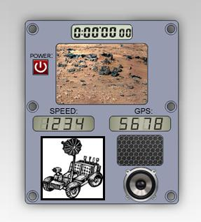
Subsystem 6: Electrical
Requirements: AIAA Telemetry/Electronics Award
High gain antenna, TV camera, two batteries, electronic control panel – radio, display, vehicle controls
Control Panel Design:
Strain Gauges
Gyroscope
Camera for visibility
Radio
GPS
Arduino Mega Microcontroller
Challenges:
Strain gauge integration with structure

Slide 12
Future Work
New Approach:
Team collaboration on each subsystem
Establish faculty mentors for each system
Monthly design reviews
Engineering exercises

Slide 13
Conclusion
Project Objectives & Approach
Competition Requirements
Subsystems
Objective
Design
Challenges
Future work

Slide 14
Questions?

